Slide 1
SOX9-dependent fibrosis drives renal function in nephronophthisis A comparison of the proteomics analysis
Team 1: Leticia, Milda and Mai

Slide 2

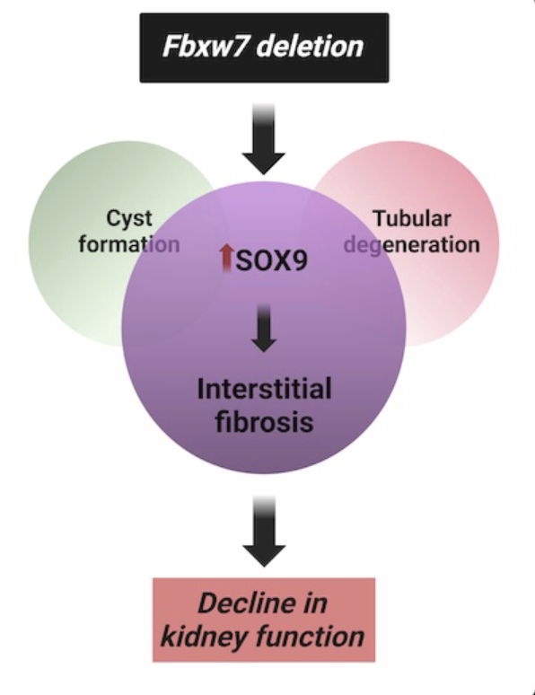
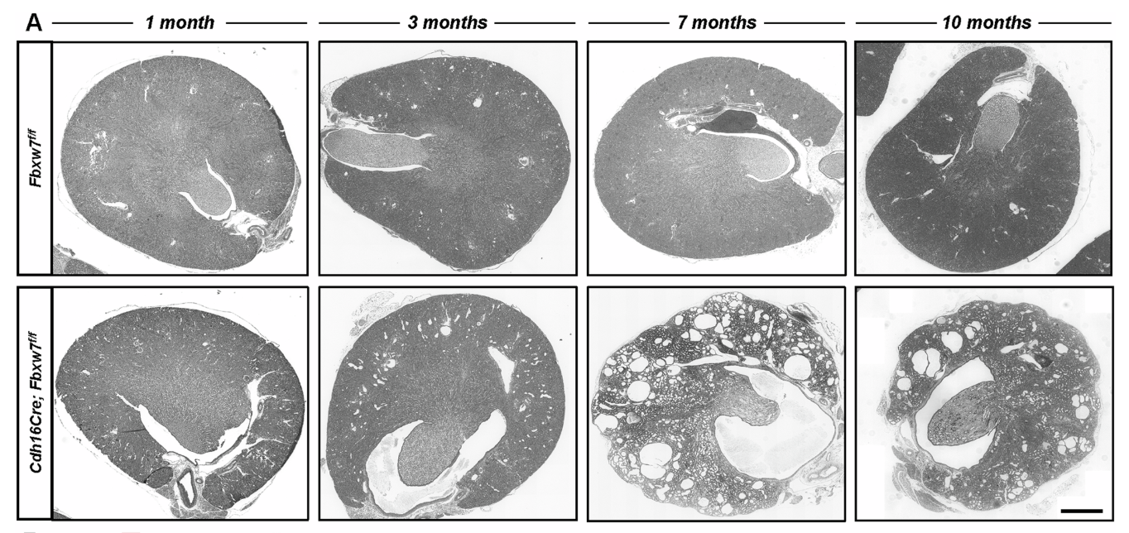
Background
What are the molecular mechanisms underlying renal fibrosis?
Fibrosis is an important pathological feature and outcome prediction marker for many renal diseases.
Deletion of Fbxw7 in the mouse renal epithelium recapitulates nephronophthisis (NPHP) pathology (A)
Fbxw7 KO induces the Sox9-Wnt axis, which appears as an important driver of fibrosis.

Slide 3
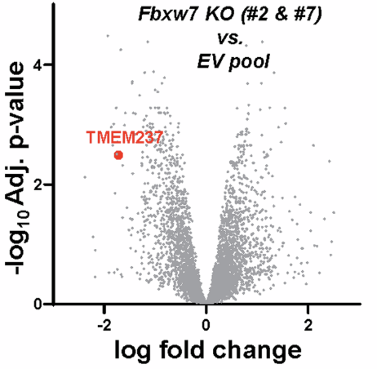
Background
Proteomics analysis:
Cas9-mediated Fbxw7 deletion in mIMCD3 cells
2 clones:
Fbxw7-KO #2
Fbxw7-KO #7
Controls:
Parental cell lines
EV controls

Slide 4
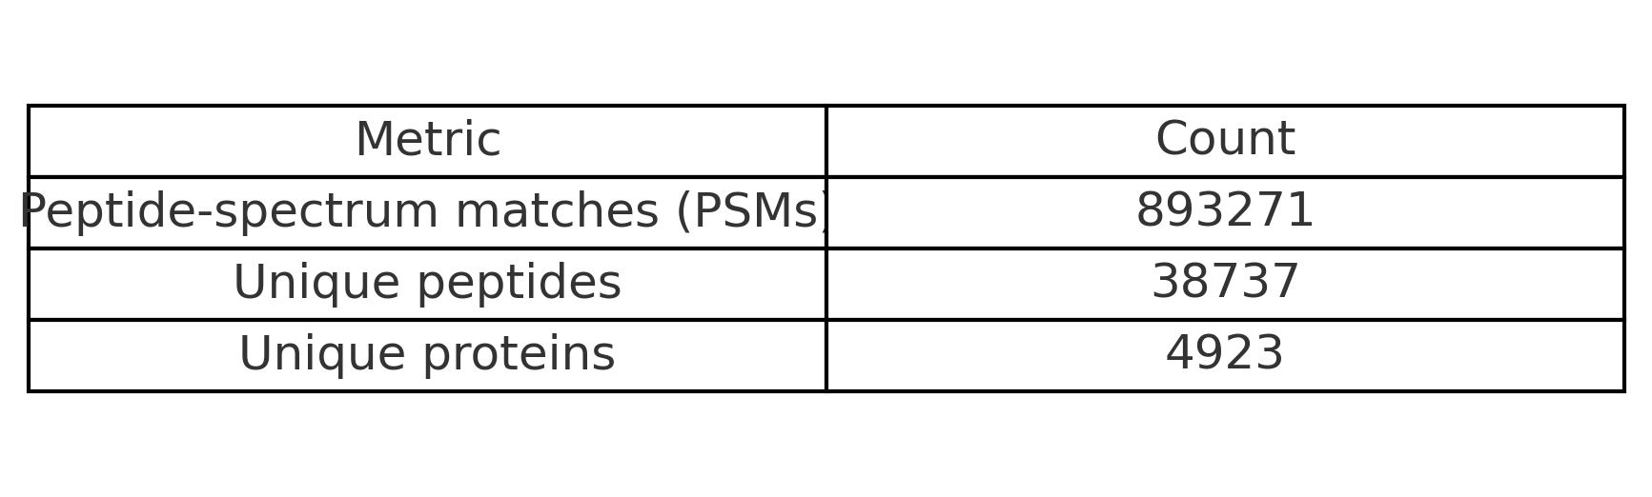
Overview of Identified Spectra, Peptides, and Proteins

Slide 5
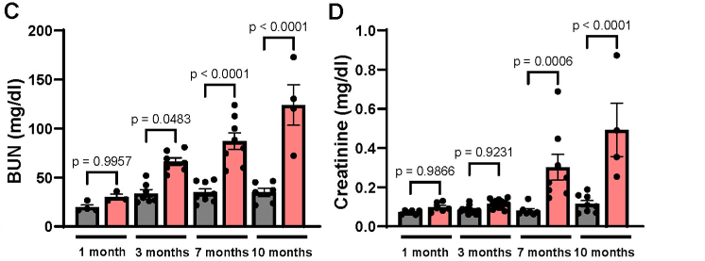
FBXW7 Deletion Mimics Nephronophthisis (NPHP)
Researchers deleted FBXW7 in mouse kidney epithelial cells.
Mice developed classic NPHP features: → cysts, tubular degeneration, and fibrosis → with early kidney function decline.
They also saw increased inflammation, suggesting an active pathogenic process.

Slide 6
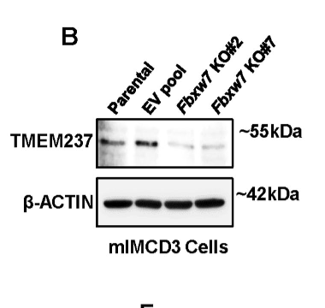
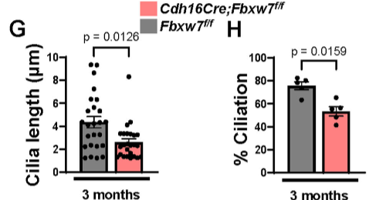
TMEM237 Downregulated: A Clue from Proteomics
Proteomics analysis of Fbxw7-null kidney cells revealed TMEM237 as significantly downregulated.
TMEM237 is a known cilia-associated protein, mutations in it cause Joubert syndrome, which includes NPHP-like symptoms.
They confirmed:
↓ TMEM237 by mass spec and western blot.
Also found shorter cilia and fewer ciliated cells.

Slide 7
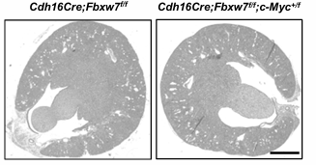
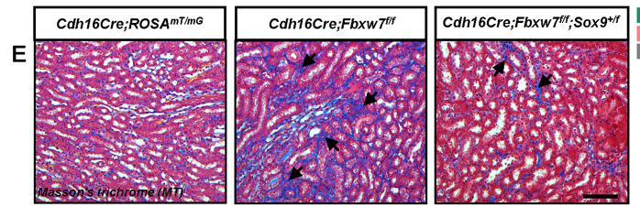
SOX9 and c-MYC Rise — But Not Equally
Among upregulated proteins: SOX9 and c-MYC, both known FBXW7 targets.
Researchers tested each:
c-MYC: Partial deletion did not improve pathology.
SOX9: Partial deletion reduced fibrosis, improved kidney function.
SOX9 levels also increased in:
Patient kidney biopsies (NPHP1)
Other mouse models with cilia defects

Slide 8

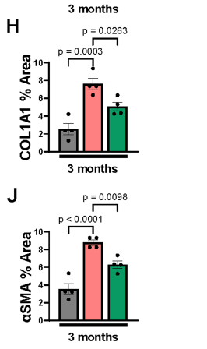
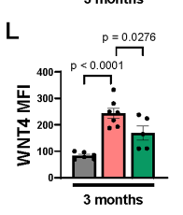
SOX9–WNT4 Axis: The Fibrotic Culprit
SOX9 drives expression of WNT4, a pro-fibrotic signal.
FBXW7-null kidneys → ↑ SOX9 → ↑ WNT4 → ↑ fibrosis markers (COL1A1, α-SMA).
Deleting one Sox9 allele:
↓ WNT4
↓ fibrosis
↑ kidney function

Slide 9
Technical details
Dataset: PXD061542
Organism/Model: For the proteomics analysis, Fbxw7 KO IMCD-3 cell lines (mouse).
Technology: Orbitrap Exploris 480 mass spectrometry
Source: PRIDE repository (ProteomeXchange Consortium)
Experiment Type: Data-independent Acquisition (DIA)

Slide 10
Data acquisition and PSM creation and pre-processing
Accessed via R package: rpx
No .mzID files provided by authors
mzML files containing raw data → encyclopeDIA
EncyclopeDIA:
Generate chromatogram library,
PSM files and integrated quantification
Used the outputs of EncyclopeDIA for downstream analysis
(.features.txt files to create PSM object)
Mus musculus reference FASTA file
Prosit-generated library as scaffold

Slide 11
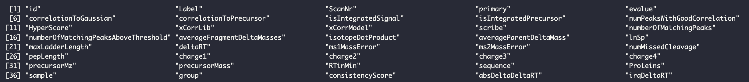
Data acquisition and PSM creation and pre-processing
.features.txt files column names
HyperScore as Score to consider best fit
Manually adding rank by grouping per spectrum and based on HyperScore
Filtered for rank == 1
No multi-matching spectrum
No FDR correction because the peptide / protein identification in EncyclopeDIA already FDR < 0.01

Slide 12
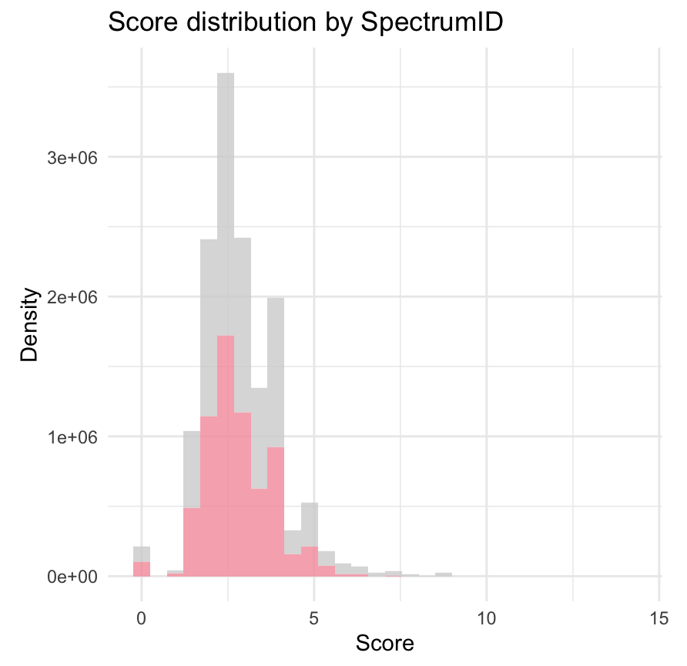
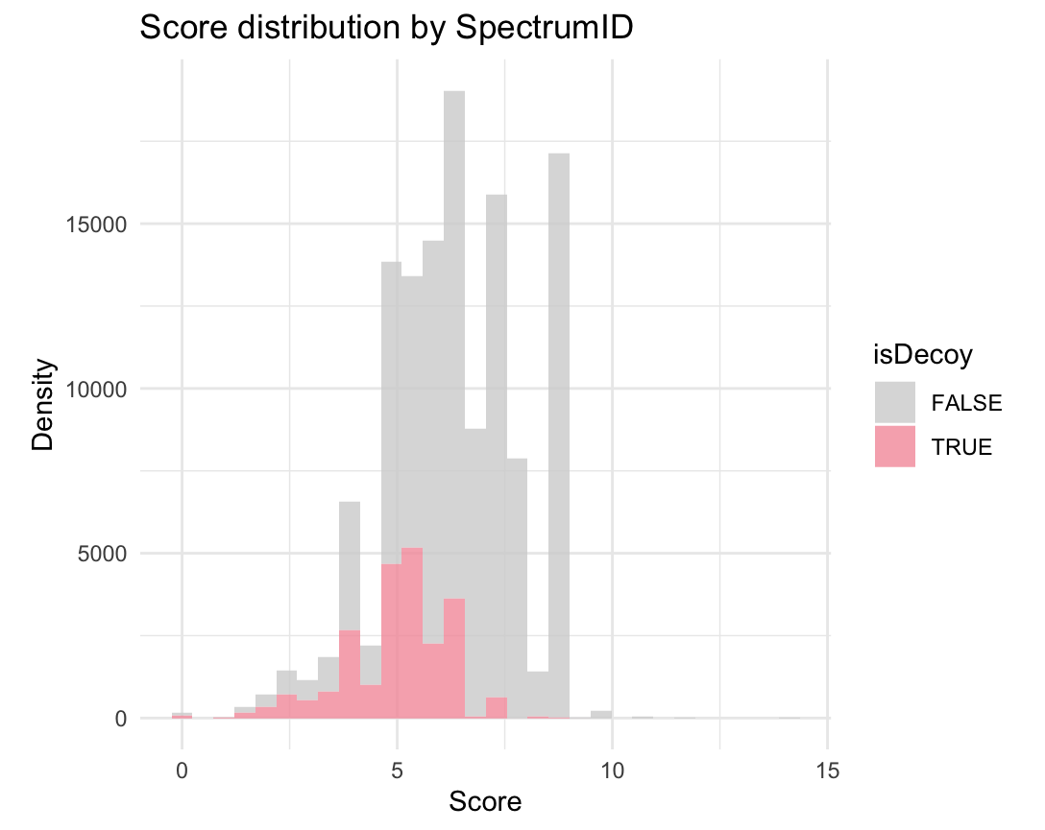
Score distribution before and after rank filtering
→ Before
After

Slide 13
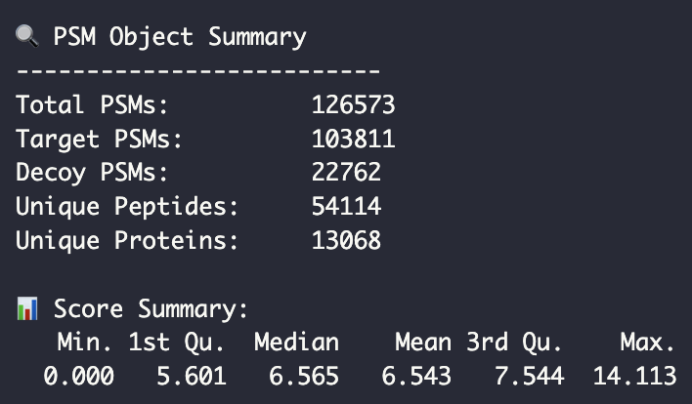
PSM object summary

Slide 14
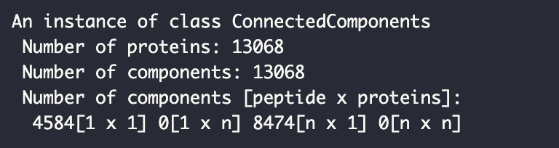
Razor peptides and protein groups
8464 proteins identified by multiple peptides
No single peptide shared by multiple proteins → no “razor” peptides

Slide 15
Protein aggregation
Peptide quantification (from EncyclopeDIA)
QFeatures conversion
0 → NA
Removed peptides with > 20% missing data
Peptide-based normalisation
log2 transform
Impute missing data (knn)

Slide 16
Protein aggregation
Peptide quantification (from EncyclopeDIA)
QFeatures conversion
0 → NA
Removed peptides with > 20% missing data
Peptide-based normalisation
log2 transform
Impute missing data (knn)
Mean-centered
Median-centered

Slide 17
Protein aggregation
Peptide quantification (from EncyclopeDIA)
QFeatures conversion
0 → NA
Removed peptides with > 20% missing data
Peptide-based normalisation
log2 transform
Impute missing data
Median-centered normalization
Protein aggregation
Knn
Robust summary
Notes:
We normalise a the peptide level because you take into account technical variation effects, which occur in the peptides because that’s what you are measuring

Slide 18
Differential expression analysis
Peptide
Protein

Slide 19
Differential expression analysis
Msqrob2, with default parameters:
Fits a model using robust linear regression on the protein expression values that have been aggregated from the peptide intensities
On protein level
Contrasts: KO vs WT (pooled parental and EV cell lines): 5 / 5

Slide 20
Differential expression analysis

Slide 21
Differential expression analysis
WT
KO

